Slide 1
Electoral Roll Matters

Slide 2
SRER 2019: Calendar of Activities for preparation of Final E-Roll and EPICs
Milestones | Timeframe | Activities
1 | By 07/11/2018 | Data Entry - of Form 6, 6A, 7, 8 & 8A and suo-moto cases, Assignment of Parts and BLO Checklist generation.
2 | By 10/11/2018 | Field Verification of BLO Checklist by BLOs and authentication of checklist by BLO and applicants.
3 | By 13/11/2018 | Necessary updation of records as per findings after field verification and uploading of verified check list and AERO's observation.
4 | By 15/11/2018 | Completion of all required field level hearing process.

Slide 3
5 | By 18/11/2018 | Necessary updation of records, if required, after hearing under supervision of EROs.
6 | By 20/11/2018 | Disposal of all DSEs and logical errors
7 | By 22/11/2018 | Generation of updated list of applications and thorough verification in presence of BLOs, Supervisors and AEROs.
8 | By 23/11/2018 | Disposal of all claims and objection after final approval of ERO and assignment of EPIC.
9 | On 25/11/2018 | “Single Day Hearing Programme” for DSEs (only for matched and doubtful cases as decided by ERO after the table top exercise and field verification by BLOs) across AC within the District / across AC within the State

Slide 4
10 | By 27/11/2018 | Generation of Approval/Rejection list by the ERO and its thorough checking in presence of the BLOs, Supervisors and AEROs.
11 | By 29/11/2018 | Certification by ERO on correctness of electoral data (Certificate-1)
12 | From 01/12/2018 | Generation of EPIC and data entry of exact address in EPIC module of ERMS for preparation of EPIC
13 | By 03/12/2018 | Generation of Test Copy of Final Electoral Roll PDF (Supplement-1)

Slide 5
14 | By 06/12/2018 | 100% Checking of Test Copy of Final E-Roll PDF by ERO to ensure 100% correctness of electoral data including top-sheet information. BLOs, Supervisors & AEROs to be involved in the process and Certification by ERO on correctness of electoral data (Certificate-2)
15 | By 12/12/2018 | Arrangement for printing of Final E-Roll PDF and Mother Roll (Integrated Draft E-Roll) with markings of deletion & corrections of Supplement-1
16 | By 15/12/2018 | 100% Checking of Final E-Roll and Mother Roll (integrated draft Electoral Roll) with markings of deletion & corrections of Supplement-1 and Final Certification by ERO on correctness of electoral data including top-sheet information (Final Certificate).
Notes:
14
By 06/12/2018
100% Checking of Test Copy of Final E-Roll PDF by ERO to ensure 100% correctness of electoral data including top-sheet information. BLOs, Supervisors & AEROs to be involved in the process and Certification by ERO on correctness of electoral data (Certificate-2)
15
By 12/12/2018
Arrangement for printing of Final E-Roll PDF and Mother Roll (Integrated Draft E-Roll) with markings of deletion & corrections of Supplement-1
16
By 15/12/2018
100% Checking of Final E-Roll and Mother Roll (integrated draft Electoral Roll) with markings of deletion & corrections of Supplement-1 and Final Certification by ERO on correctness of electoral data including top-sheet information (Final Certificate).
17
By 18/12/2018
Submission of image and without image PDF of Supplement-1 and Mother Roll (integrated draft Electoral Roll) with markings of deletion & corrections to CEO WB.
18
By 20/12/201814
By 06/12/2018
100% Checking of Test Copy of Final E-Roll PDF by ERO to ensure 100% correctness of electoral data including top-sheet information. BLOs, Supervisors & AEROs to be involved in the process and Certification by ERO on correctness of electoral data (Certificate-2)
15
By 12/12/2018
Arrangement for printing of Final E-Roll PDF and Mother Roll (Integrated Draft E-Roll) with markings of deletion & corrections of Supplement-1
16
By 15/12/2018
100% Checking of Final E-Roll and Mother Roll (integrated draft Electoral Roll) with markings of deletion & corrections of Supplement-1 and Final Certification by ERO on correctness of electoral data including top-sheet information (Final Certificate).
17
By 18/12/2018
Submission of image and without image PDF of Supplement-1 and Mother Roll (integrated draft Electoral Roll) with markings of deletion & corrections to CEO WB.
18
By 20/12/2018
Format 1-8 Report to ECI.
Format 1-8 Report to ECI.

Slide 6
17 | By 18/12/2018 | Submission of image and without image PDF of Supplement-1 and Mother Roll (integrated draft Electoral Roll) with markings of deletion & corrections to CEO WB.
18 | By 20/12/2018 | Format 1-8 Report to ECI.
19 | On 04/01/2019 | Final E-Roll Publication 2019.
Notes:
14
By 06/12/2018
100% Checking of Test Copy of Final E-Roll PDF by ERO to ensure 100% correctness of electoral data including top-sheet information. BLOs, Supervisors & AEROs to be involved in the process and Certification by ERO on correctness of electoral data (Certificate-2)
15
By 12/12/2018
Arrangement for printing of Final E-Roll PDF and Mother Roll (Integrated Draft E-Roll) with markings of deletion & corrections of Supplement-1
16
By 15/12/2018
100% Checking of Final E-Roll and Mother Roll (integrated draft Electoral Roll) with markings of deletion & corrections of Supplement-1 and Final Certification by ERO on correctness of electoral data including top-sheet information (Final Certificate).
17
By 18/12/2018
Submission of image and without image PDF of Supplement-1 and Mother Roll (integrated draft Electoral Roll) with markings of deletion & corrections to CEO WB.
18
By 20/12/201814
By 06/12/2018
100% Checking of Test Copy of Final E-Roll PDF by ERO to ensure 100% correctness of electoral data including top-sheet information. BLOs, Supervisors & AEROs to be involved in the process and Certification by ERO on correctness of electoral data (Certificate-2)
15
By 12/12/2018
Arrangement for printing of Final E-Roll PDF and Mother Roll (Integrated Draft E-Roll) with markings of deletion & corrections of Supplement-1
16
By 15/12/2018
100% Checking of Final E-Roll and Mother Roll (integrated draft Electoral Roll) with markings of deletion & corrections of Supplement-1 and Final Certification by ERO on correctness of electoral data including top-sheet information (Final Certificate).
17
By 18/12/2018
Submission of image and without image PDF of Supplement-1 and Mother Roll (integrated draft Electoral Roll) with markings of deletion & corrections to CEO WB.
18
By 20/12/2018
Format 1-8 Report to ECI.
Format 1-8 Report to ECI.

Slide 7
Some Immediate Activities
As per instruction of the Commission, a meeting of the BLOs with BLAs shall be held on 16.12.2018 (Sunday) at 12 noon, at all polling stations
Maters related to the suo-moto actions taken in respect of the entries to be deleted like that of deceased electors/permanently shifted electors/multiple entries shall be discussed.
All recognized political parties shall be intimated and adequately briefed about the meeting and they shall be requested to depute their BLAs to attend the said meeting.
Prior to the meeting it shall be ensured that as per the instructions given earlier all political parties have been provided with the list of claims and objections received during the period of SRER 2019.

Slide 8
Some Immediate Activities
A certificate shall also be taken from the BLOs that they have conducted 100% verification and collected details/information/requisite forms.
Similar certificate needs to be submitted by the EROs and DEOs
However, as the period for filling claims and objections is already over, the Forms collected by BLOs during the period after last date of filling claims and objections shall be kept aside and taken up for disposal by EROs/AEROs during continuous updation after final publication of rolls of the current summary revision.

Slide 9
Re-Printing of Mother Roll
Commission’s instruction no. 23/LET/ECI/FUNC/ERD/ER/2018-II Dt. 25th September, 2018
In an election year, at the time of Final Publication of E-Roll the following has to be done:
The basic mother roll (integrated draft roll) shall be reprinted. The reprinted mother roll shall remain the same as was published at the time of draft publication, except the following changes –
(i) The word "D E L E T E D" shall be superimposed diagonally (computer-generated) on the elector detail box concerned to indicate that the said entry has been deleted in Supplement 1.

Slide 10
Re-Printing of Mother Roll
In the 'deletion' Supplement, the alphabets, ‘E' ‘S' ‘Q' ‘R' or 'M‘ shall be pre-fixed against serial number of each deleted entry to denote the reason for deletion.
(E = Expired, S = Shifted, R = Repeated, Q = Disqualified, M = Missing).
(ii) Secondly, a hash (#) sign shall be prefixed before serial number of each of the entry corrected to indicate that the entry has been corrected in the 'correction' list of Supplement 1, but no correction actually should be carried out in the reprinted mother roll.

Slide 11
Re-Printing of Mother Roll
(iii) Similarly, photographs of electors corrected in the supplement 1 will not be changed in the reprinted mother roll. Photograph of an already registered elector replaced subsequently, should be listed in the 'correction' list and retained therein. In the reprinted mother roll, in the space provided for photograph, the words “Photo as in Correction List" in bold should be printed.

Slide 12
Hosting of Electoral Rolls on website
Only image pdf (non-editable) of electoral rolls, with only details and without photograph of electors, are hosted on the CEOs' website and the access to view such image PDF of electoral rolls is strictly provided through CAPTCHA containing alphabet, numeral and special character as per instruction of ECI
Wherever soft copy of the electoral rolls (draft / final) is supplied to anyone under the provisions of law and in pursuance of the Commission's instructions, such rolls should be in image PDF Format (non-editable) with only the details and without the photographs of electors.

Slide 13
Components of E-Roll for Poll
Commission’s instruction no. 23/LET/ECI/FUNC/ERD/ER/2018-II Dt. 25th September, 2018
Events | Timeframe of Publication | Components of E-Roll
Draft Publication of Electoral Rolls | On 01.09.2018 | Integrated Draft E-Roll (Mother Roll)
Final Publication of Electoral Rolls | On 04.01.2019 | Supplement 1
Another supplement of continuous updation for the period between the final publication and last date of making nominations | After Last Date of Filing of Nomination | Supplement 2

Slide 14
Preparation of working copy of Electoral Roll
Ensure timely preparation of working copies.
About 15 sets of rolls to be prepared-
For candidates of recognized political parties-one each
For polling party -4 sets
For safe custody of DEO/RO
For reserve

Slide 15
ELECTORAL ROLL
Sharing of Electoral Rolls before the Polls
(ECI instruction No. 22/2/INST/ECI/FUNC/ERD/ER/2017 dated 10th January, 2017)
The Commission has directed that Mother Roll shall also be printed alongwith all supplements using the software provided for the purpose, at the end of the period of continuous updating after the last date of nomination is over, so that there should be no need to make any corrections in the electoral roll by hand. A copy of this electoral roll with the Mother Roll and supplements printed by software shall be given free of cost to contesting candidates of recognised political parties and will also be made available for sale by the ERO to other persons. The same copy shall also be used for preparation of the Marked copy of electoral rolls to be used in polls.

Slide 16
Work at ERO Level -
To ensure that electoral roll supplied to candidates and the copy set apart for markings (for use in conduct of poll) are identical, the Commission has directed that Mother roll shall again be printed along with the supplements 1 & 2.
One integrated draft roll (reprinted at the time of publication) one supplement of final publication and another supplement of continuous updation.
The basic mother roll (integrated draft roll) shall remain same as was published in draft except in following 4 manners :-
The word "D E L E T E D" to be superimposed diagonally (computer generated) on the elector detail box to indicate that the entry has been deleted in the Supplement. In the Supplement, the alphabets, 'E' 'S' 'Q' 'R' or 'M' shall be pre fixed against Sr. No. of each deleted entry to denote the reason for deletion. . (E = Expired, S = Shifted, R = Repeated, Q = Disqualified, M = Missing).

Slide 17
A hash (#) sign shall be prefixed before Sr. No. of the entry corrected to indicate that the entry has been corrected in the supplement but no correction actually should be carried out in the draft (mother) roll.
Photographs of electors corrected in the supplement will not be added/changed/corrected.
However, in the space provided for photograph, the words "Photo as in Correction List" in bold should be printed.
Where the photo in draft roll is wrong and correct photo is not captured before final publication in such case "photo deleted" may be imprinted on the wrong photo in the mother roll and a # sign affixed to indicate the change in Suppplement.

Slide 18
ERO shall supply one authenticated copy of complete roll along with PDF version to the DEO and the RO in a sealed cover.
ERO shall give a few more copies and a CD of the roll in a printable form to the DEO/RO for making copies required for use in election.

Slide 19
At RO Level -
RO to reflect all the deletions and corrections, if any, appearing in Supplements.
At Supplement 1 stage (of final publication) the roll is computer generated and all deletions/corrections are software generated.
At Supplement 2 stage also (for the period between the final publication and last date of making nominations) the roll is computer generated and all deletions/corrections are software generated.
The officials entrusted to verify the deletions/corrections of supplements should put his signatures on each page of part of the roll.

Slide 20
Maintenance of a register by RO showing names and designation of officials who carried out authentication of the deletions and corrections of Supplements. Not more than 4 officials per AC segment be deputed.
In case of Auxiliary PSs two copies of roll of that part - Non relevant pages / part of page to be deleted by putting cross (×) marked by hand with ink – Official should put his full signature also.
Entries relating to EDC and PB in working copy and marked copy.
Working copies and Marked Copies of E-Roll should be completed by 2 days before dispatch of polling parties.

Slide 21
Classified Service Voters
Classified Service Voters (R. 27P & 49F of CE Rules, and ECI No. 3/1/2003 JS-II dt. 23.9.2003 and No. 22/2/06 PLN-II dt. 24.3.2006) –
List of CSVs shall also be supplied to the candidates of recognized parties
PS wise sub list of CSVs and proxy to be added to the end of relevant part of roll
One copy of list of CSVs for entire constituency to be forwarded to DEO in a sealed cover.

Slide 22
Authentication of working copies
Ref :ECI No. 22/2/2006 PLN-II dt. 24.3.2006; No. 22/2/2007 & ERS dt. 06.11.2007 and No. 22/2/2008 PLN-II dt. 8.8.2008) –
Certificate by RO/ARO (ink signed) in prescribed format to be attached on top of marked copy.
One copy to be used as marked copy - In case of auxiliary polling stations S. Nos. of voters also to be indicated clearly in the aforesaid certificate.
Total number of deletions and corrections, both in words and figures be also indicated in the certificate.

Slide 23
Supply of working copies of rolls to candidates of recognized parties
Ref : (R. 85D of CE Rules, 1961, ECI No. 3/1/2003 JS-II dt. 13.11.2003; No. 22/2/07 - ERS dt. 06.11.2007 and No. 22/2/2008 PLN-II dt. 8.8.2008) –
Complete set of roll, free of cost, to be supplied.
Working copies of rolls and the copies of rolls supplied to such party candidates should be identical.
Computer generated electoral roll at Supplement 1 & 2, carrying all deletions/ corrections, along with shall be given to such party candidates.
List of CSVs also to be supplied to such candidates.

Slide 24
Electoral roll in alphabetical order
Ref : ECI No. 23/Locator/2007 ERS dt. 05.11.2007) –
Part wise roll in alphabetical order, preferably in English for use of "Voter Assistance Booth“.
Such booth to be established only in premises where three or more PSs situated.
At other locations roll in alphabetical order will be used by PrO in addition to working copy.

Slide 25
List of Absentee/Dead /Shifted voters
RO to prepare PS wise list of ASD voters in the roll.
The list will be used for identification of critical polling stations.
The list of Absentee/Shifted/Dead voters will also be given to the Pro.

Slide 26
Distribution of Photo Voter Slips (PVS) to the Electors by BLOs
The Official PVS will be printed in the size of ‘Half of A-4 paper’ i.e. 8 inches by 6 inches
The PVS shall be printed with proper accounting on both sides, as per the sample given by the Commission
Good quality paper should be used for printing
Printing quality should be of high standard so as to ensure clear, legible and unambiguous image and content.

Slide 27
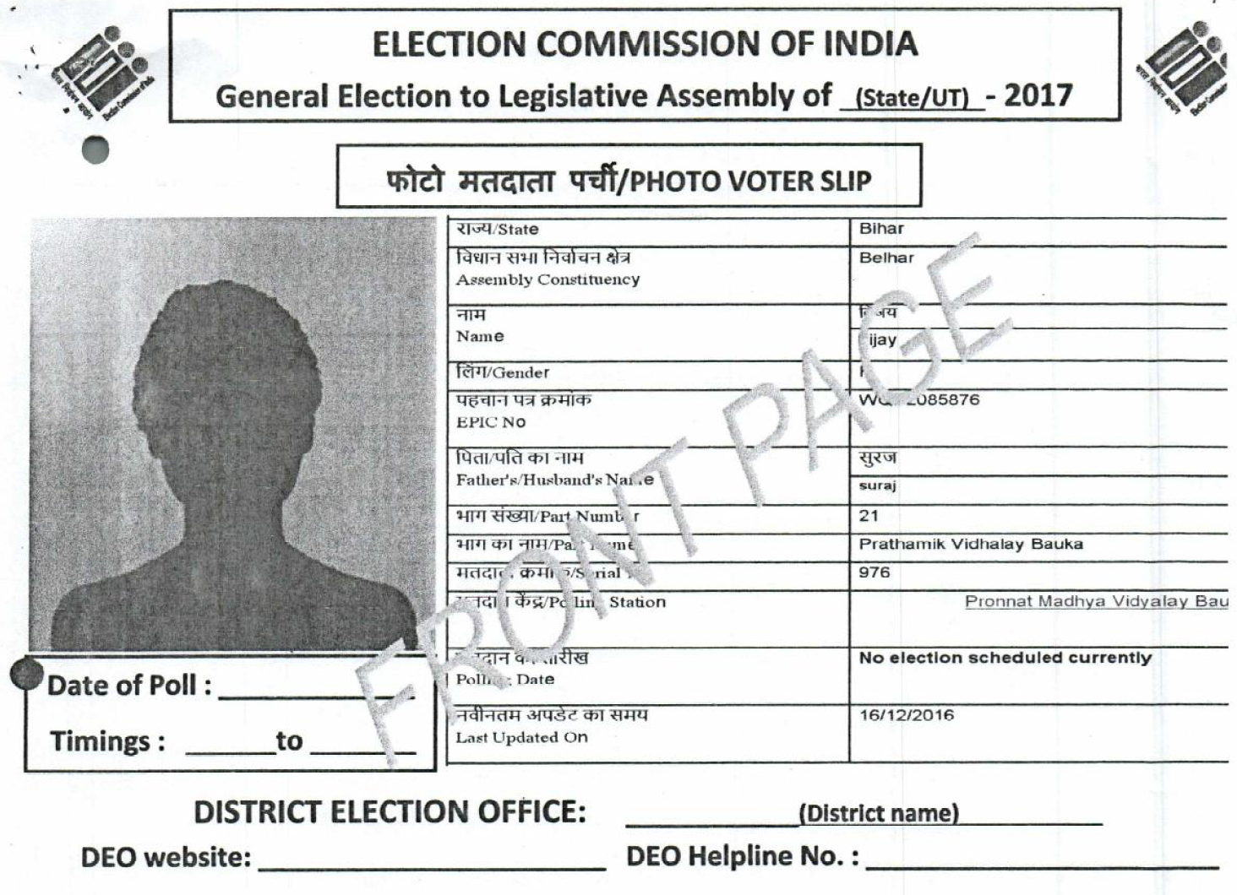

Slide 29
Distribution of Photo Voter Slips (PVS) to the Electors by BLOs
(No.464I1NST –VS/2014-EPS, Dated: 21st March, 2014 & 19th Jan, 2017)
The Photo Voter Slips shall be printed on a good quality paper, ensuring clear entries and photographs of voters appearing thereon.
Only one (1) set of Photo Voter Slips would be printed for the registered electors of each Assembly Constituency, duly authenticated by the ERO, for distribution through the BLOs.

Slide 30
PVS …..
The Photo Voter Slips should be issued under original signatures of the BLOs.
The BLO shall give the Photo Voter Slip either to the voter or to an adult member of the voter's family who is himself/ herself a voter.
The BLO shall obtain the signature/ thumb impression of the person to whom the Photo Voter Slip is delivered, as an acknowledgement of having received the Photo Voter Slip.

Slide 31
PVS …
The marking of Absent/ Shifted/ Dead (ASD) Voters shall also be done on the Photo Voter Slips.
The RO shall prepare a schedule for distribution of Photo Voter Slips by the BlOs.
A copy of this schedule shall be given by the RO to the Political Parties, Booth Level Agents (BLAs) of all recognized political parties, if they have been appointed and contesting Candidates and their Agents, under acknowledgement, well in advance and BLOs should adhere to it.

Slide 32
PVS …
The DEOs shall ensure that BLOs maintain absolute neutrality during the distribution of Photo Voter Slips.
RO/ Sector Officers should randomly check that distribution of Photo Voter Slips
Bulk distribution of the Photo Voter Slips shall not be allowed by BLO or any other person.
Distribution should be completed at least five clear days before the date of poll. Daily reporting shall be made in CEO’s Portal till completion.

Slide 33
Distribution of Photo Voter Slip (PVS).
(ECI instruction No. 464/INST/VS/2017-EPS dated 19th January, 2017)
All undistributed Photo Voter Slips (PVS) shall be returned by the BLO to the concerned ERO, who shall keep the same in the sealed cover under safe custody.
No further distribution of PVS would be done after the same are returned to the ERO.
ERO shall make an alphabetical list of undistributed PVS in respect of each part/polling station.
Two copies of the alphabetical list shall be handed over to the RO of the constituency.

Slide 34
Thanks

